Slide 1
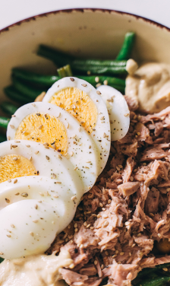
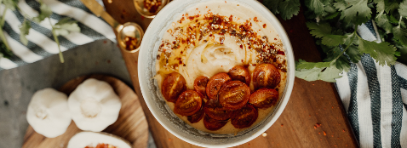
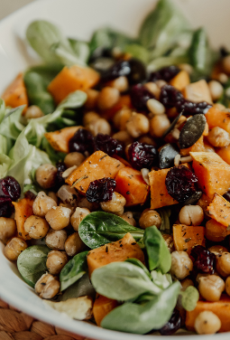
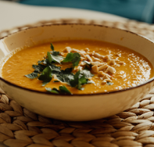
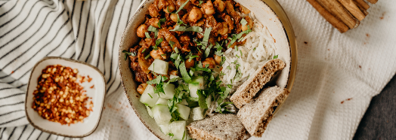
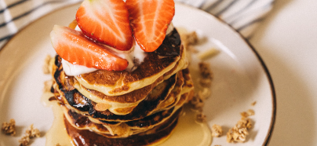
MEAL
PLANNING
SLIDES
Basics, examples, and tools to get you started

Slide 2










WHAT’S INSIDE
Why plan meals?
Meal planning guide
Key reasons to build a meal plan
Tools and tips to help you plan better

Slide 3
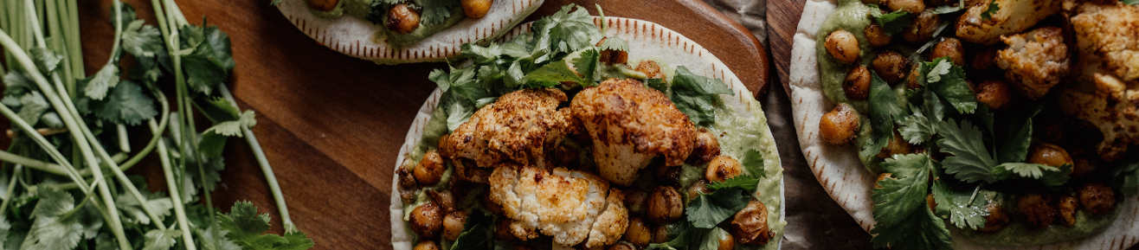
WHY PLAN MEALS?
Save time
Save money
Eat healthier
Planning ahead helps reduce last-minute cooking decisions and grocery store trips.
Sticking to a plan means you buy only what you need and make the most of leftovers.
It’s also easier to include more variety and control portion sizes.

Slide 4


YOUR MEAL
PLANNING GUIDE
01
02
03
04
05
Prepare
Start with what you have
Add favorites that are on sale
Include fruits and vegetables
Review and adjust as needed

Slide 5
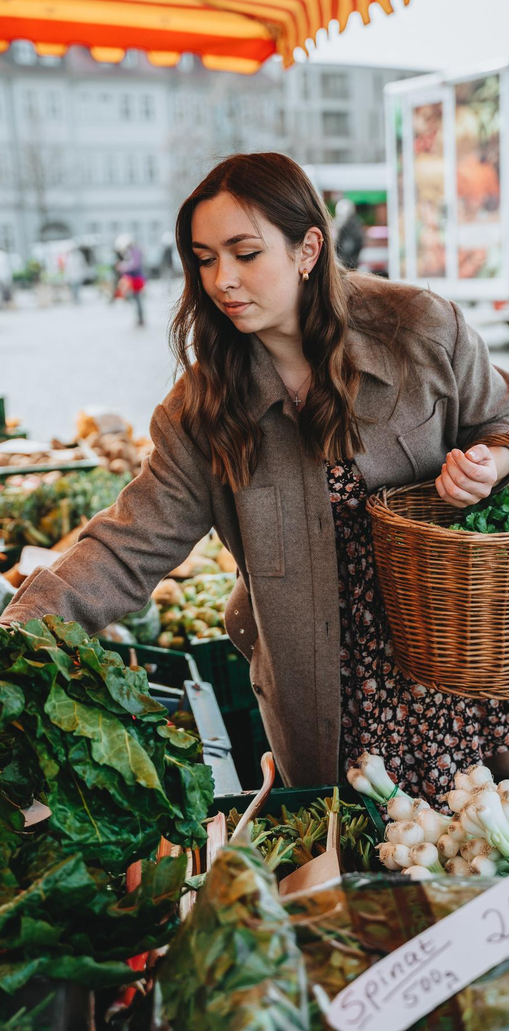
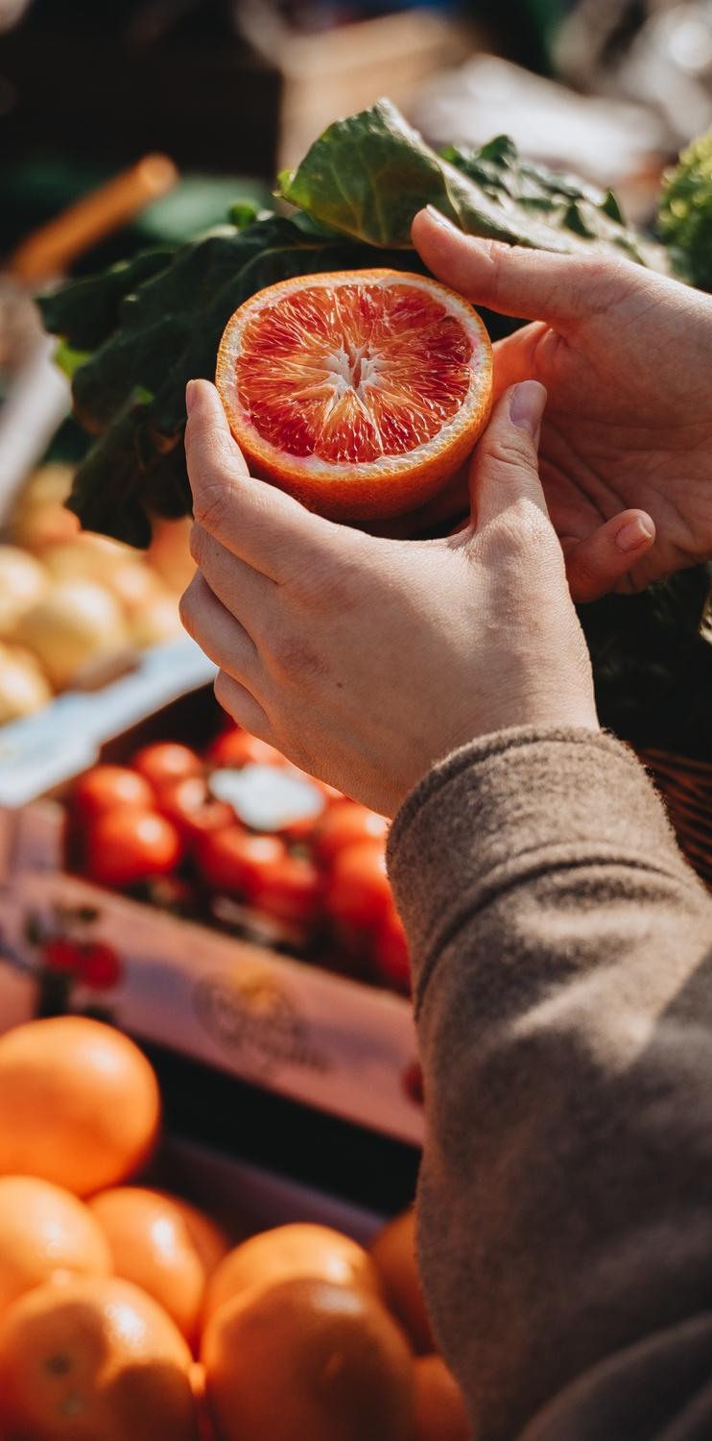
PREPARE
Before planning, consider your budget, schedule, and how many meals you need.
You can use the sample menu or meal plan on the next page to get you started.

Slide 6
SAMPLE 5-DAY MEAL PLAN
 | Day 1 | Day 2 | Day 3 | Day 4 | Day 5
Breakfast | Oatmeal with berries and almonds | Add meal here. | Add meal here. | Add meal here. | Add meal here.
Lunch | Grilled chicken salad with olive oil dressing | Add meal here. | Add meal here. | Add meal here. | Add meal here.
Dinner | Baked salmon with quinoa and broccoli | Add meal here. | Add meal here. | Add meal here. | Add meal here.
Snack | Banana and mixed nuts | Add meal here. | Add meal here. | Add meal here. | Add meal here.
Do our meals include... | ✅ Vegetable ✅ Fruit ✅ Grain ✅ Dairy ✅ Protein | ✅ Vegetable ✅ Fruit ✅ Grain ✅ Dairy ✅ Protein | ✅ Vegetable ✅ Fruit ✅ Grain ✅ Dairy ✅ Protein | ✅ Vegetable ✅ Fruit ✅ Grain ✅ Dairy ✅ Protein | ✅ Vegetable ✅ Fruit ✅ Grain ✅ Dairy ✅ Protein

Slide 7


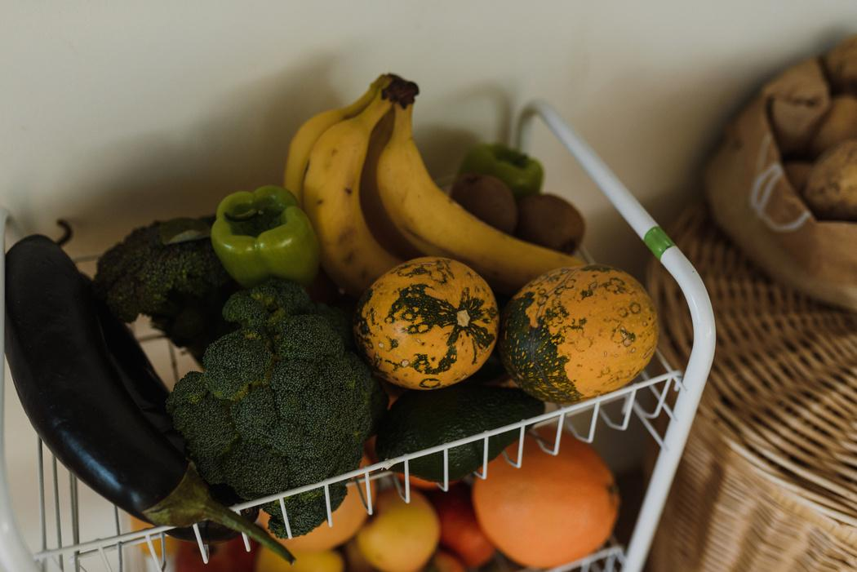
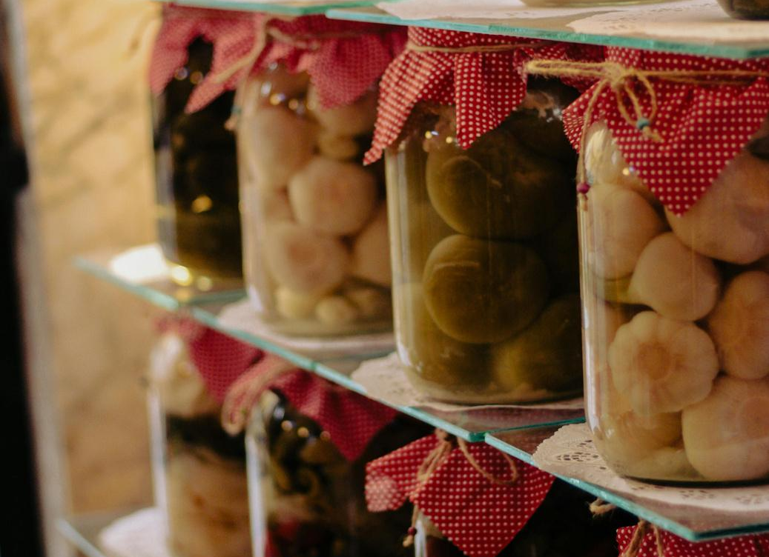


START WITH WHAT YOU HAVE
Check your pantry and freezer before buying anything new. You might already have enough to start a few meals.

Slide 8
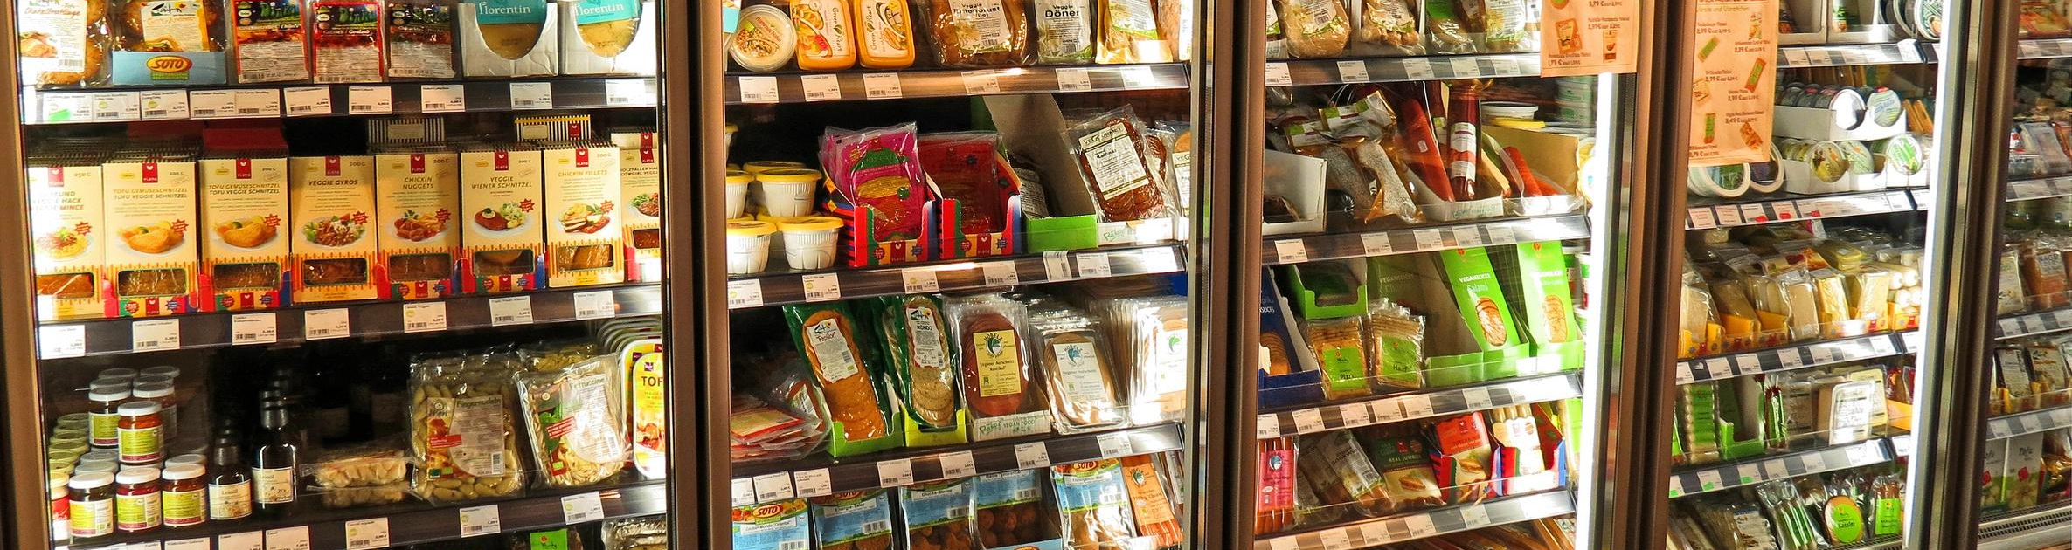
ADD FAVORITES THAT ARE ON SALE
Build your plan around healthy meals you and your family love. Then, stretch your budget by using ingredients that are on sale.

Slide 9
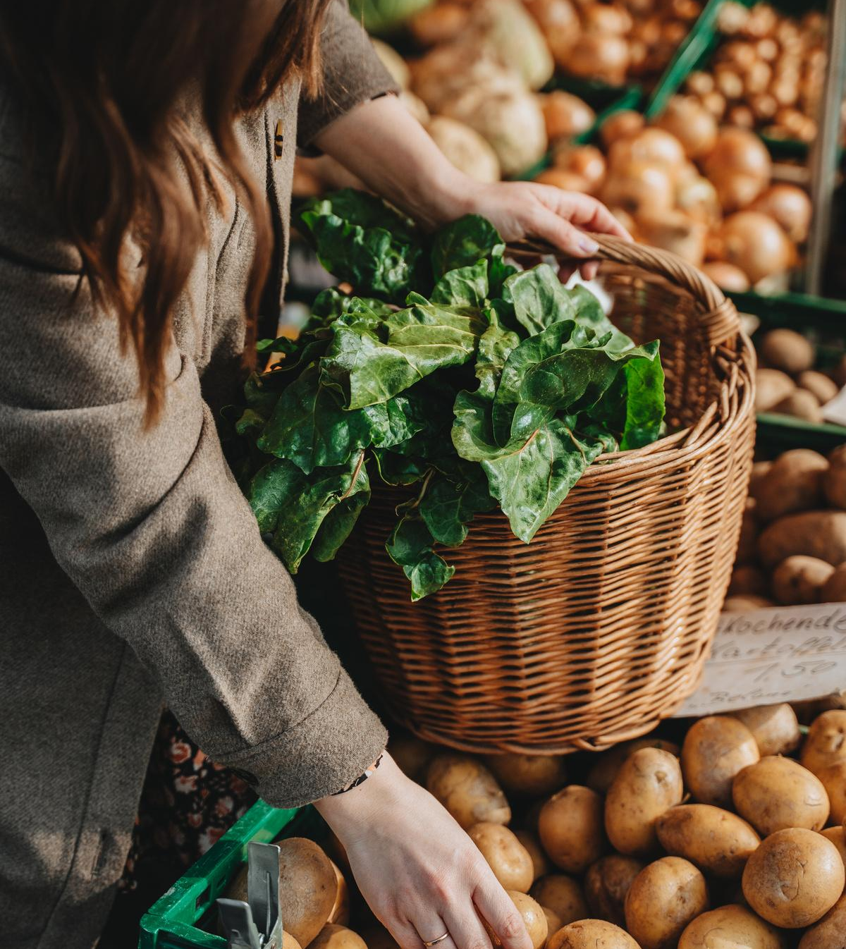
INCLUDE FRUITS AND VEGETABLES
Fresh fruits and vegetables are great, but frozen and canned count too. Make sure your meal plan includes plenty of them.

Slide 10

SEASONAL PRODUCE GUIDE
 | Spring | Summer | Fall | Winter
Fruits | Apples Apricots Strawberries Bananas Pineapple | Apples Apricots Blueberries Mangoes Watermelon | Apples Bananas Grapes Mangoes Pears | Apples Bananas Pienapple Pears Oranges
Vegetables | Broccoli Cabbage Carrots Celery Spinach | Eggplant Carrots Okra Cantaloupe Celery | Broccoli Cauliflower Mushrooms Peas Parsnips | Carrots Celery Turnips Sweet potatoes Onions and leeks

Slide 11
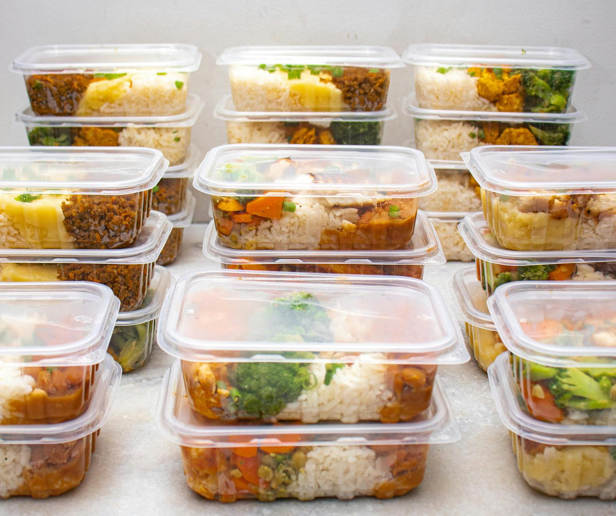

REVIEW
Look over your plan before you shop:
Is it balanced?
Does it fit your time
and budget?
Make adjustments as needed.

Slide 12
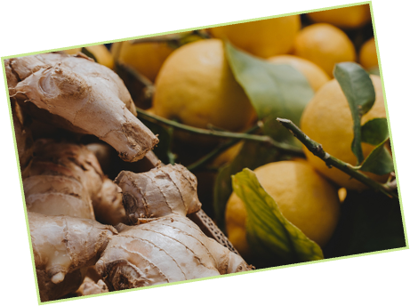
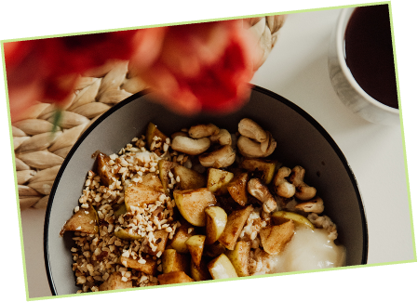
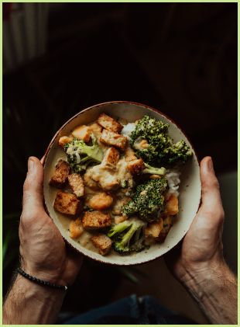
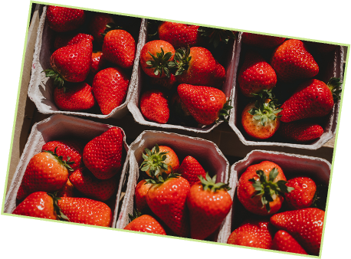
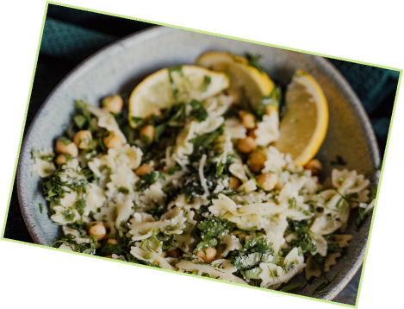
THE GREATEST WEALTH IS HEALTH
THE GREATEST WEALTH IS HEALTH
THE GREATEST WEALTH IS HEALTH
THE GREATEST WEALTH IS HEALTH
THE GREATEST WEALTH IS HEALTH
— Virgil
THE GREATEST WEALTH IS HEALTH

Slide 13
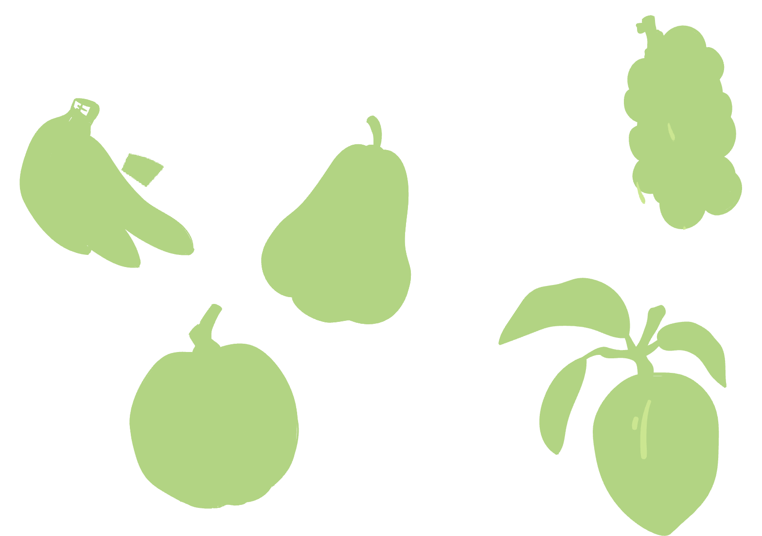
Email
hello@reallygreatsite.com
Social media
@reallygreatsite
GET IN TOUCH

Slide 14

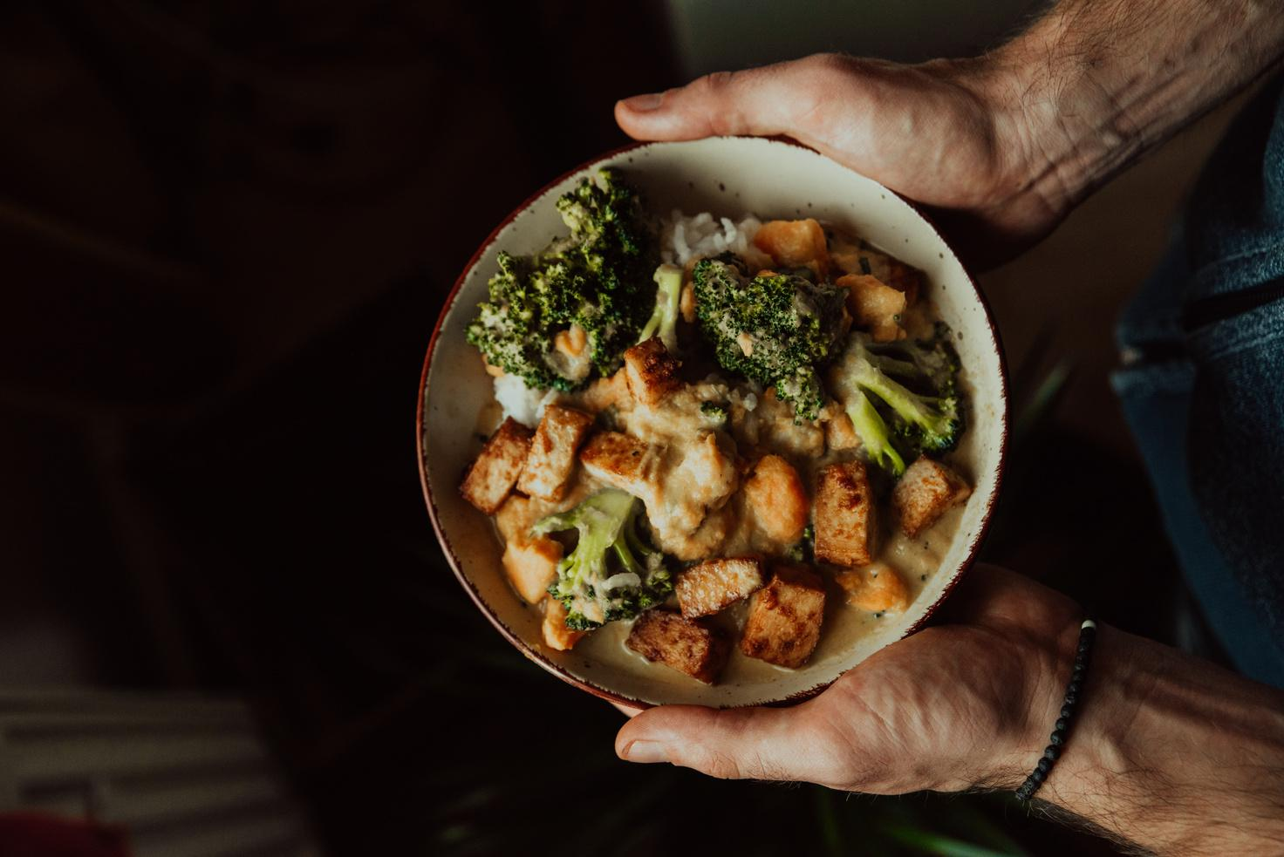
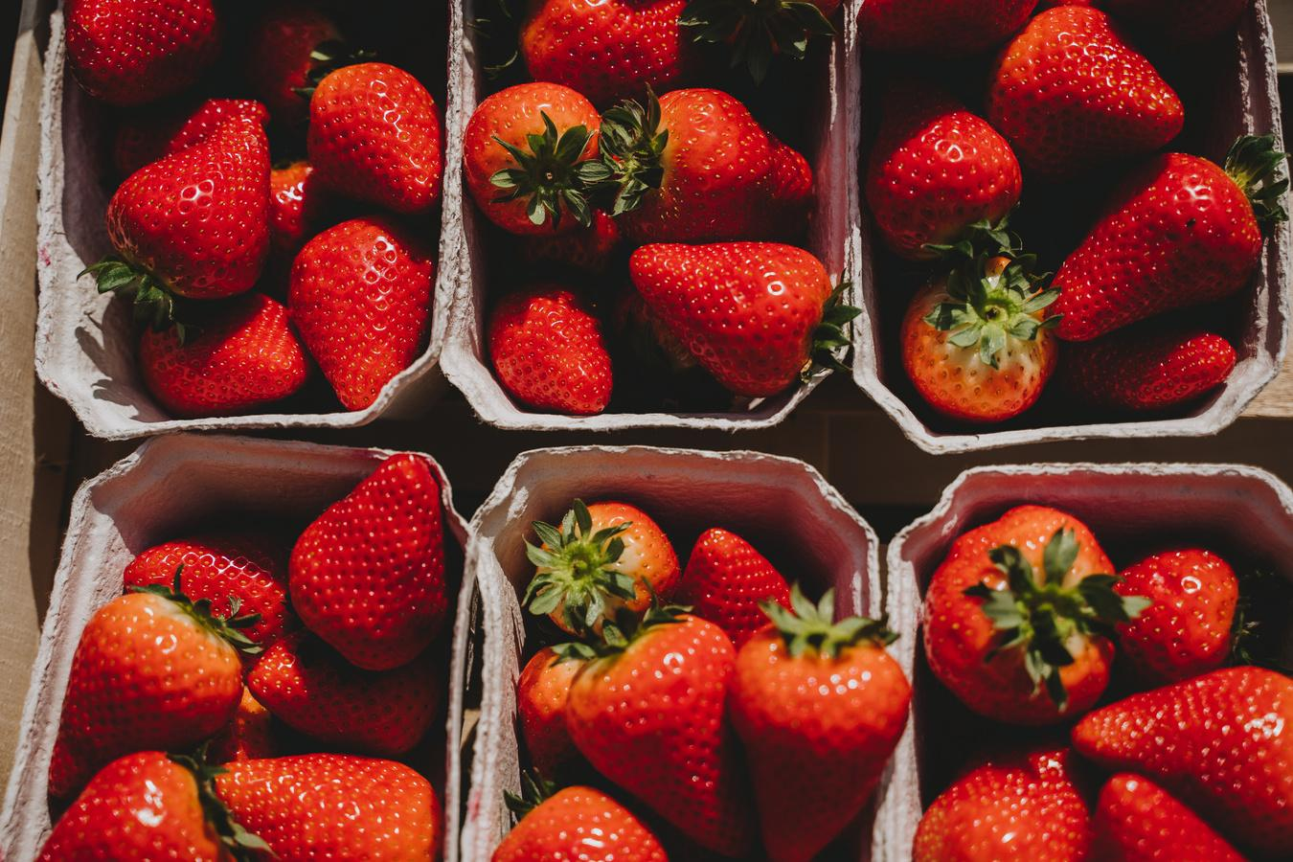
CREDITS
This presentation template is free for everyone to use, thanks to the following:
for this presentation template
Pexels, Pixabay, Sketchify
for the photos, graphics, and elements
Happy designing!

